Slide 1
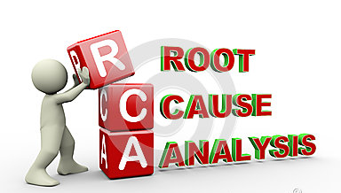
Root cause analysis
m.p.m Andy mendez (cssbb)

Slide 2
What is rca?
Root cause analysis (RCA) is a method of problem solving used for identifying the root causes of faults or problems.

Slide 3
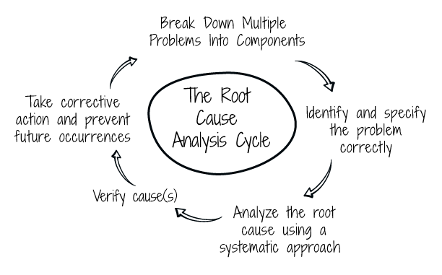
Is rca a single tool?
NO, RCA is not a tool, it is a method that might include a different set of tools and techniques.

Slide 4
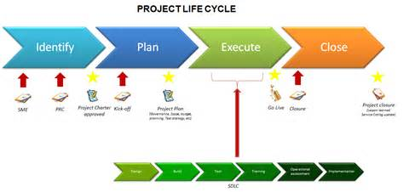
How can rca be included in methodologies such as 6s?

Slide 5
5 whys
5 Whys is an iterative interrogative technique used to explore the cause-and-effect relationships underlying a particular problem. The primary goal of the technique is to determine the root cause of a defect or problem by repeating the question "Why?" Each question forms the basis of the next question.

Slide 6
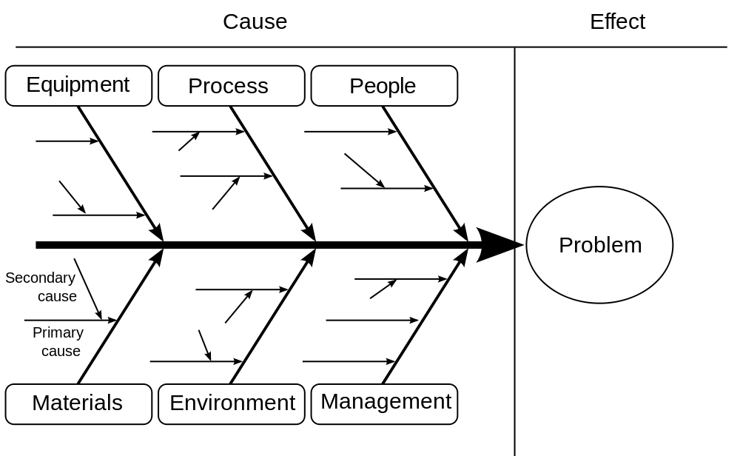
ISHIKAWA
Ishikawa diagram shows the causes of a specific event. Common uses of the Ishikawa diagram are product design and quality defect prevention to identify potential factors causing an overall effect.

Slide 7
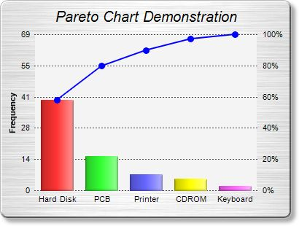
pareto
The Pareto principle (also known as the 80–f20 rule, the law of the vital few, and the principle of factor sparsity) states that, for many events, roughly 80% of the effects come from 20% of the causes.

Slide 8
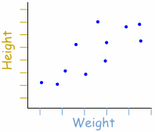
scatter plot
A scatter plot, scatterplot, or scattergraph is a type of mathematical diagram using Cartesian coordinates to display values for typically two variables for a set of data. If the points are color-coded you can increase the number of displayed variables to three.

